Slide 1
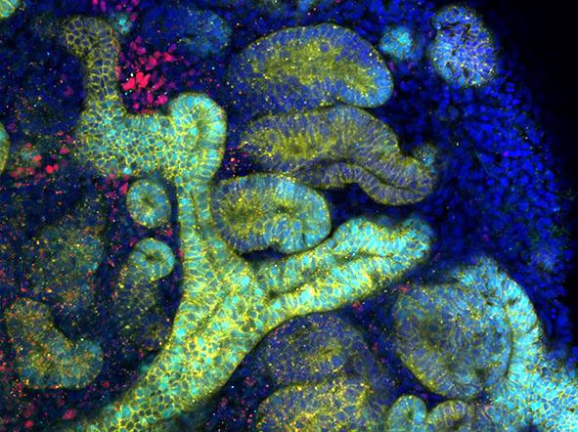
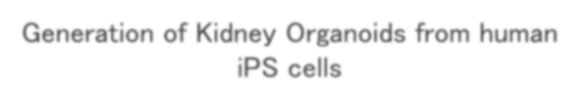
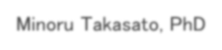


Generation of Kidney Organoids from human iPS cells
Minoru Takasato, PhD
RIKEN BDR
28/9/2021 Glycoforum

Slide 2
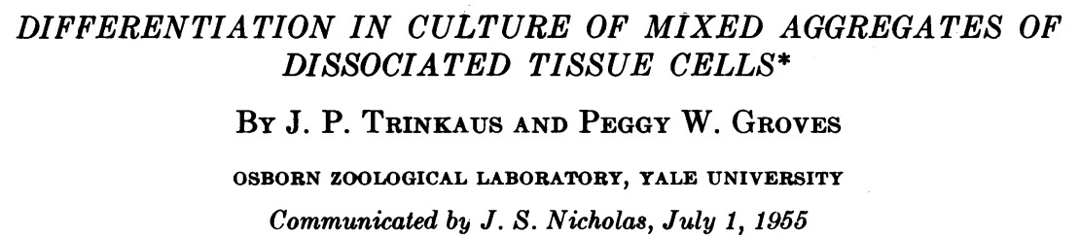
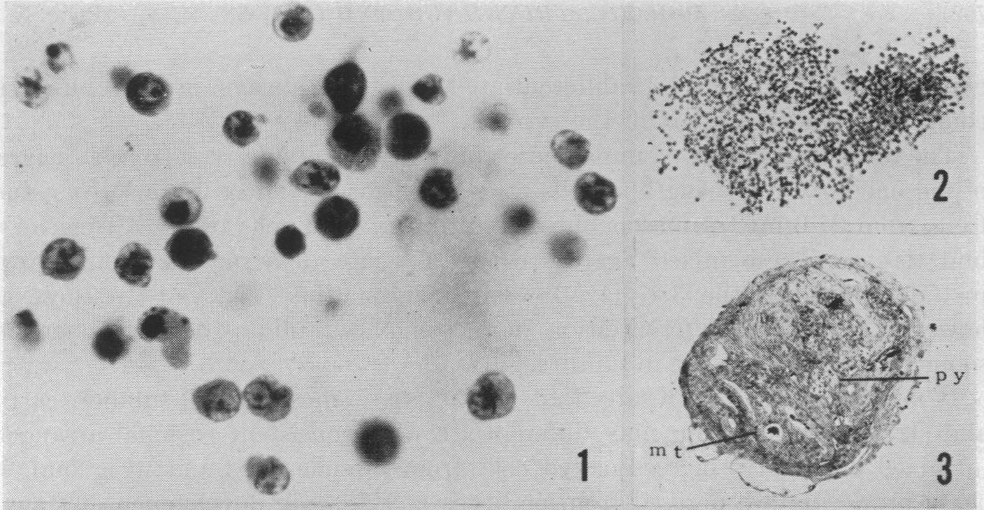
What is Organoid?
Organoid = Organ + oid (something similar to a real organ)
A common definition: Self-organizing tissues from stem cells Originally, it was an aggregate of embryonic cells.
（Trinkaus et al., PNAS 1955）

Slide 3
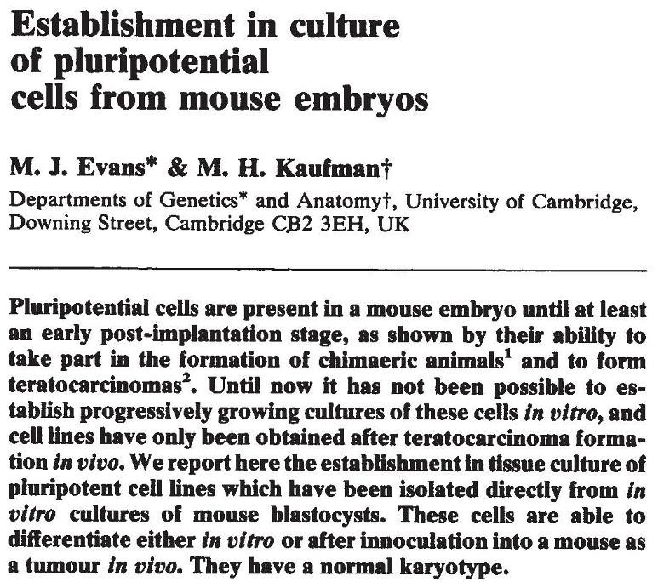
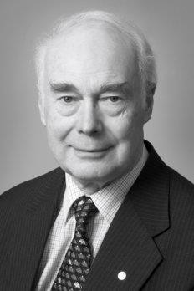
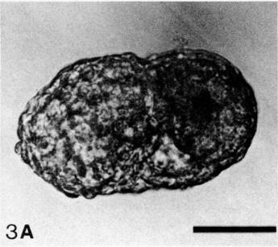
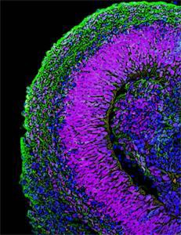
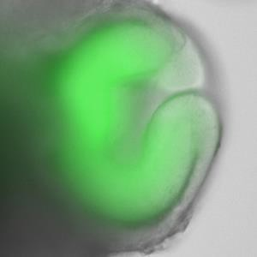
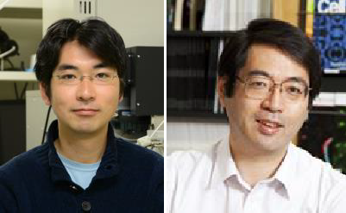
Embryoid body
Embryoid body
Sir Martin J. Evans
（Doetschman et al.,
Development 1985）
（Evans et al., Nature 1981）
Organoid from stem cells
Self-Organizing Polarized Cortical Tissues
Self-Organizing Optic-cup
M. Eiraku
Y. Sasai
（Eiraku et al., Cell Stem Cell 2008） （Eiraku et al., Nature 2011）
Organoids are not only interesting tools for studying organogenesis but also could be useful platforms for medical applications

Slide 4
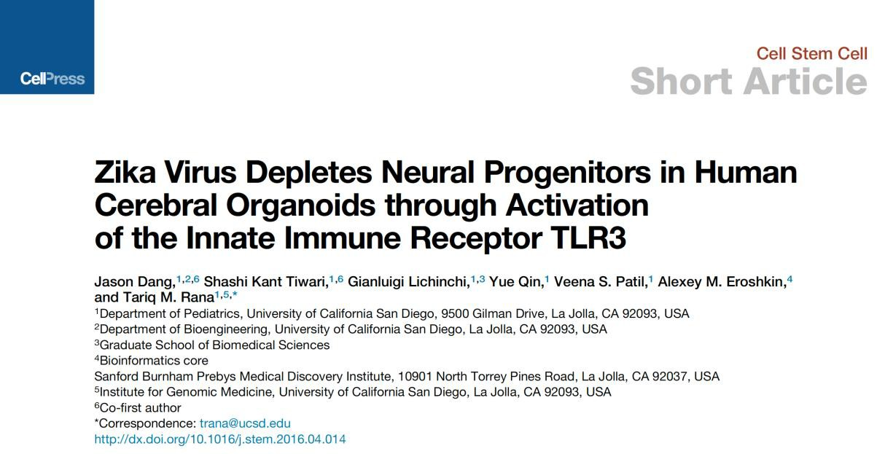
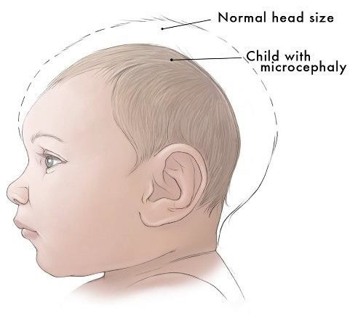
Potential of organoid technologies
Zika virus infection during pregnancy causes microcephaly in a baby
（J. Dong et al., Cell Stem Cell 2016）

Slide 5
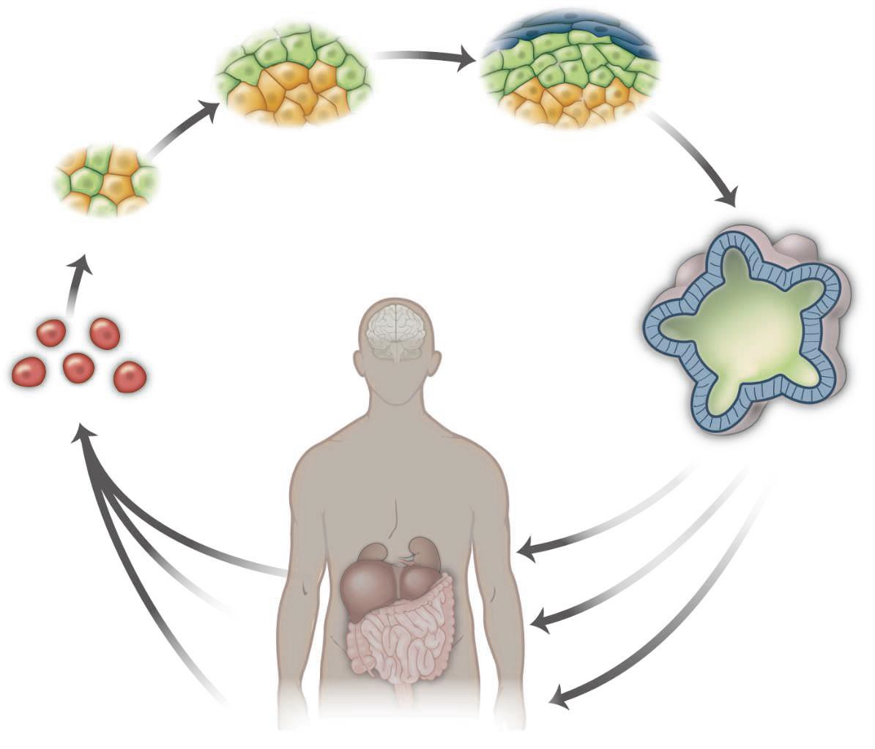
Potential of organoid technologies
selection
self-organization
differentiation
Clinical applications
organoids
stem cells
disease modeling
drug screening
tissue stem cells
transplanting
iPS cells
（modified from Lancaster and Knoblich, Science 2014）

Slide 6
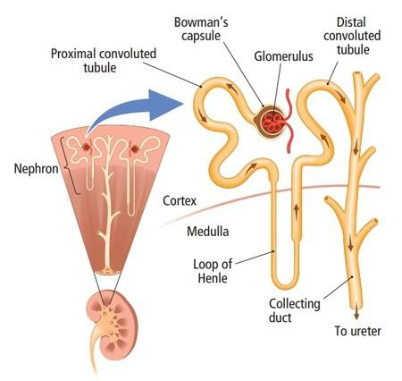
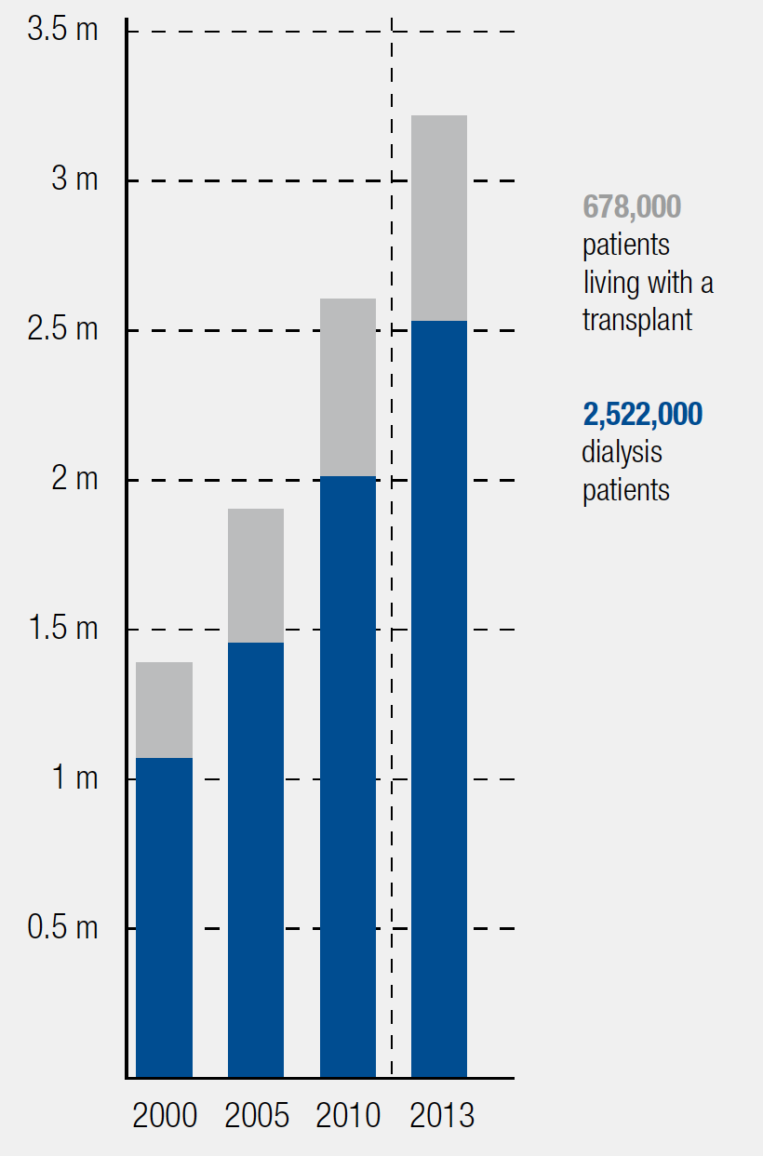
Kidney anatomy
Structure
# of ESKD patients in the world
leavingcertbiology.net (Chapter 37: The Human Urinary System)
(Fresenius Medical Care
Deutschland. 2014)

Slide 7
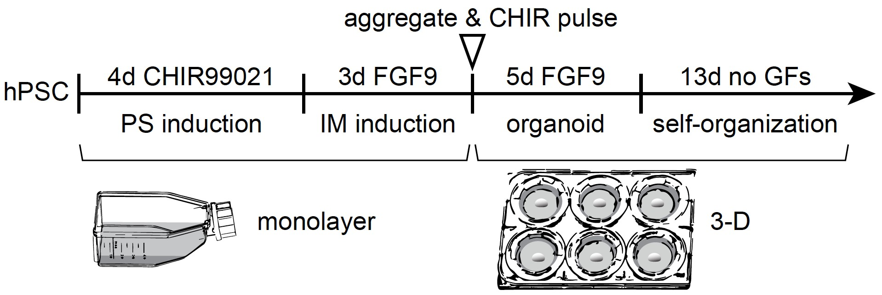
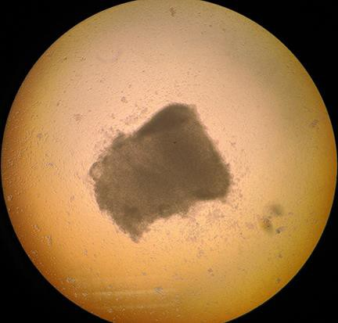
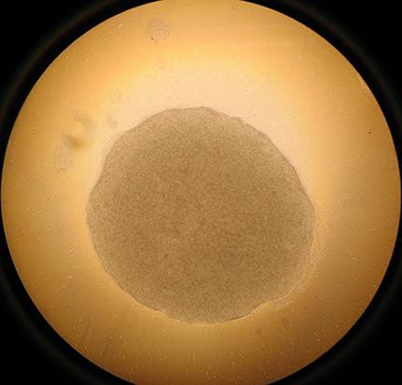
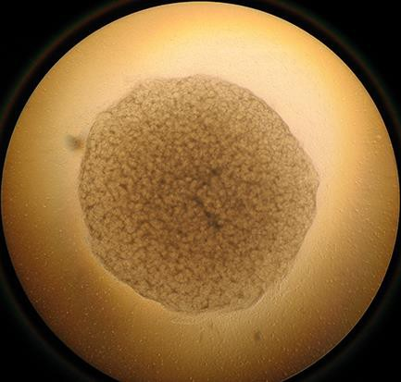
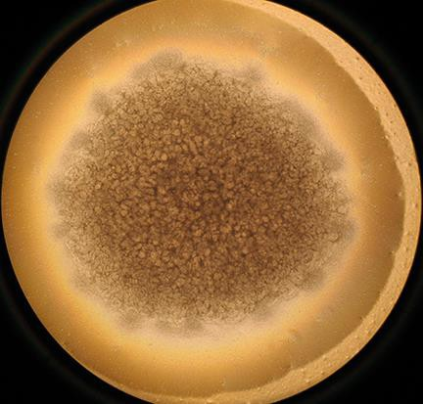
A mixture of AI + PI generated kidney organoids
pellet
3 days
11 days
18 days
(Takasato et al., Nature 2015)

Slide 8
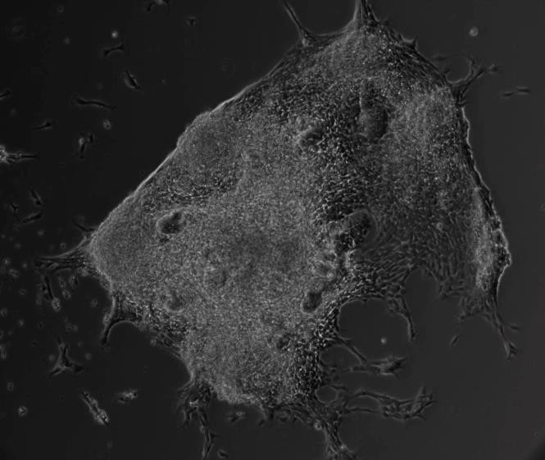
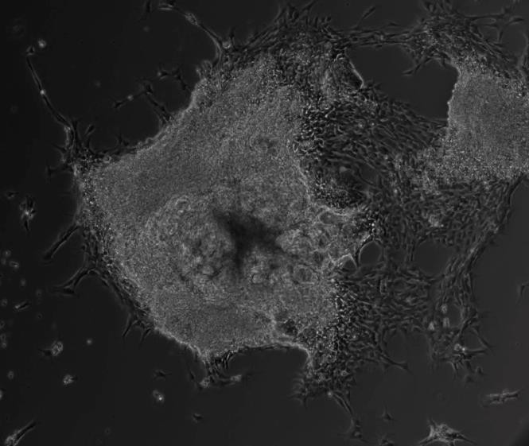
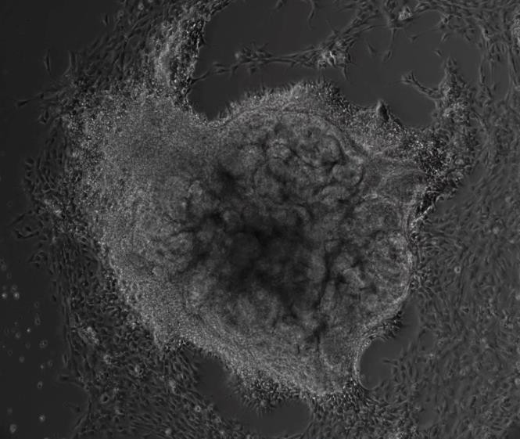
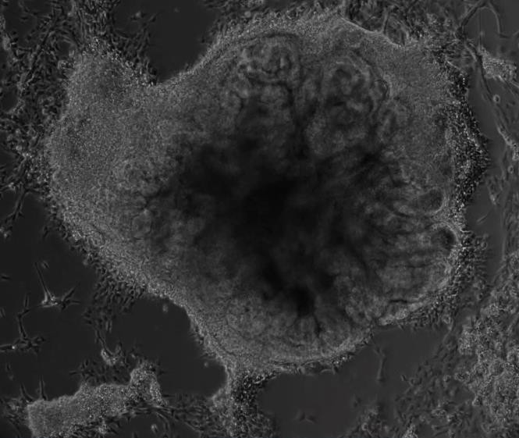
Time-lapse of a developing kidney organoid
day13
day15
day19
day22

Slide 9
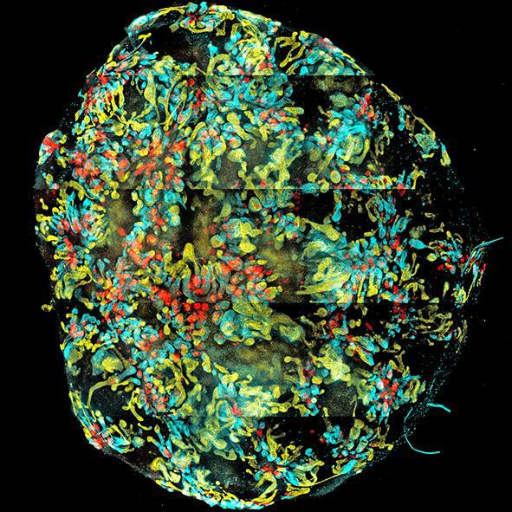
Kidney organoids comprised nephrons
distal tubules (ECAD) proximal tubules (LTL) glomeruli (NPHS1)
1 mm
(Takasato et al., Nature 2015)

Slide 10
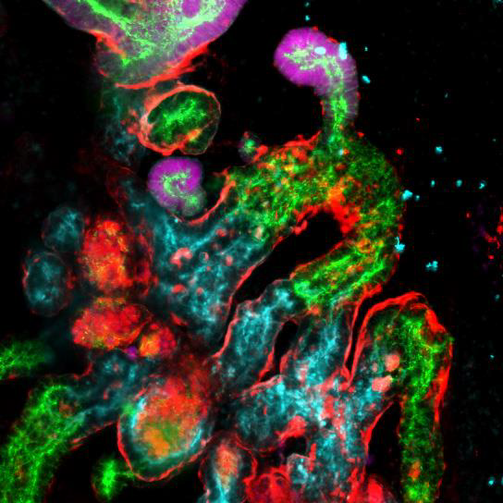

Self-organizing nephrons consisted of 4 segments
GATA3 ECAD LTL WT1
collecting duct
proximal tubule
distal tubule
glomerulus
(Takasato et al., Nature 2015)

Slide 11
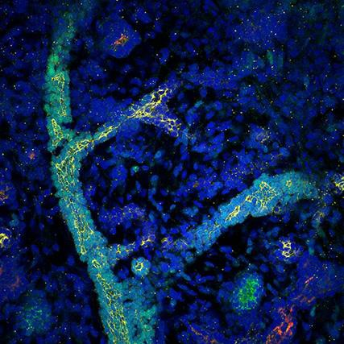
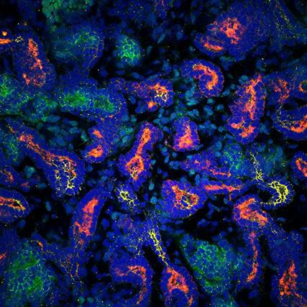
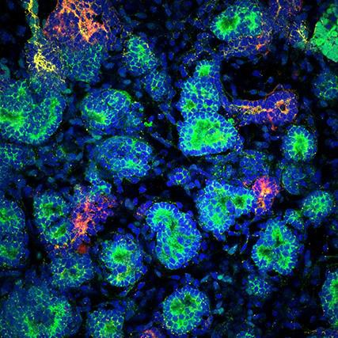
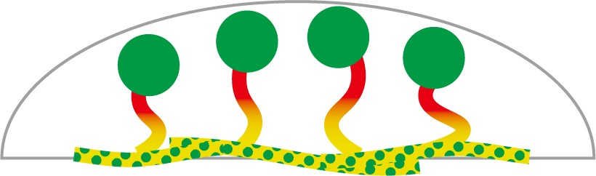
Ducts in the bottom layer, Glomeruli in the outer layer
Bottom Middle Top
Top
Middle Bottom
(Takasato et al., Nature 2015)

Slide 12
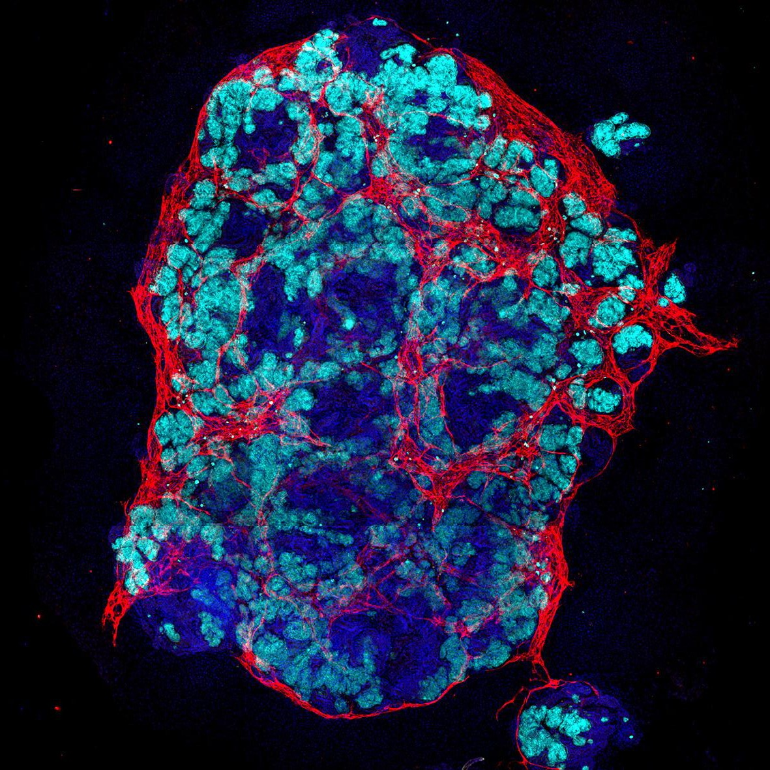
Kidney organoids contain vascular network
Glomerulus Vasculature
(Takasato et al., Nature Protocols 2016)

Slide 13
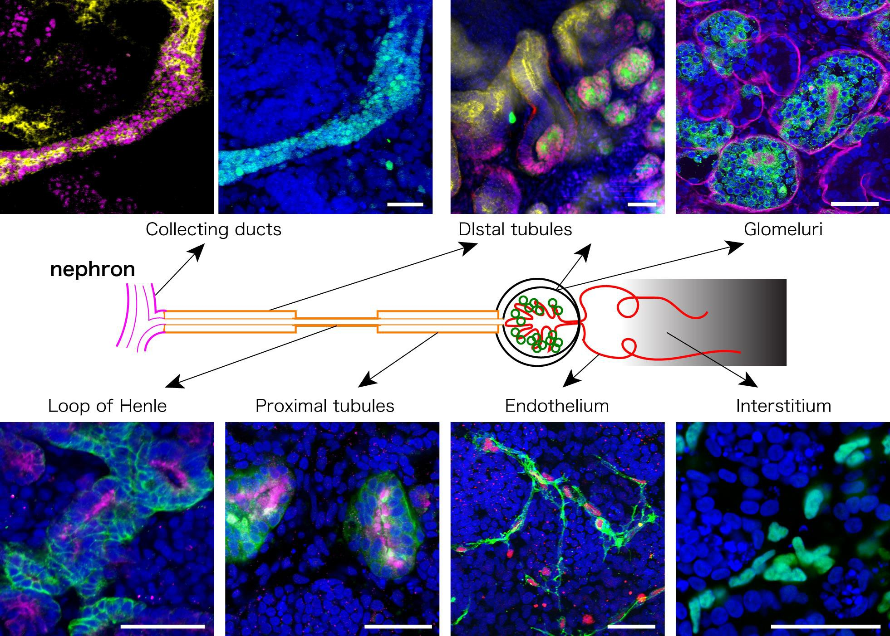
All anticipated renal structures developed in kidney organoids
Scale = 100 μm

Slide 14




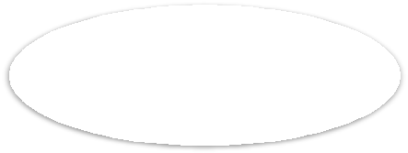
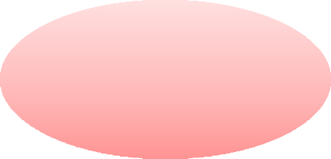








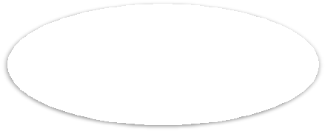
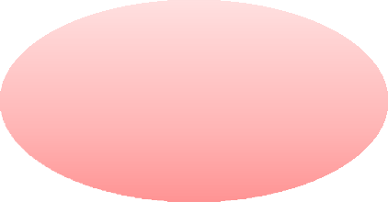

Nephrotoxicity assay for drug development
Basic phase
Pre-clinical
Clinical
Animal exp.
Candi- dates
Trial to human
approved
Cultured
cells
Check safety
2-3y
3-5y
3-5y
Success rate：1 / 30,000
Cost：Billions of Yen

Slide 15
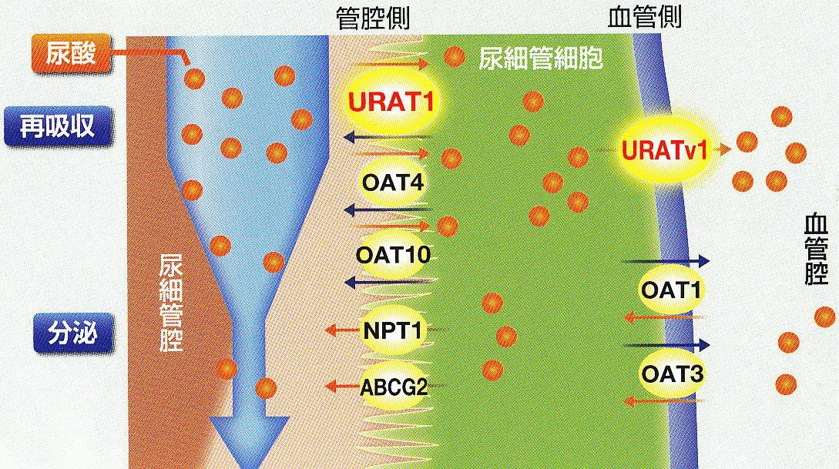
Reabsorption function of renal proximal tubules
Physiological function drives pharmacokinetics

Slide 16
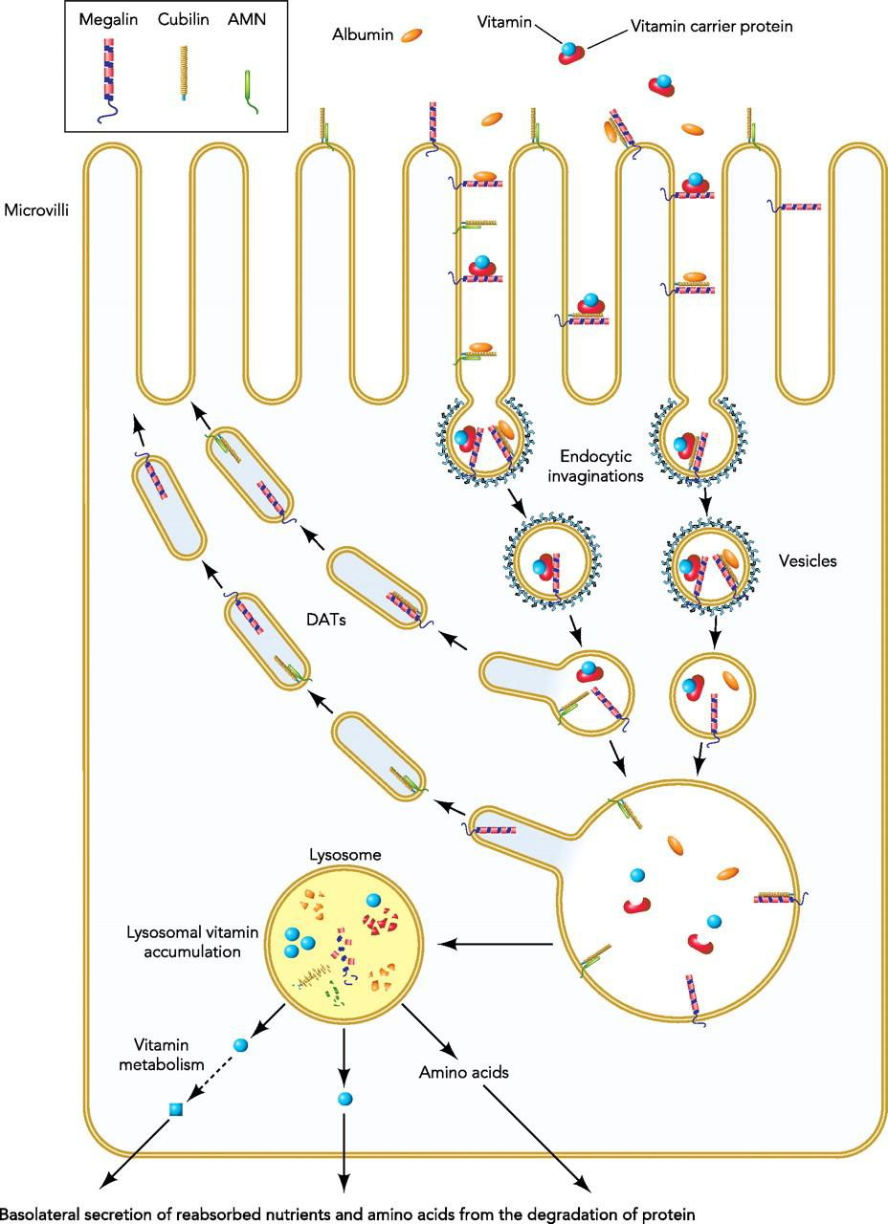
Megalin-Cubilin mediated endocytosis in PT
(Christensen et al, Physiology 2012)

Slide 17
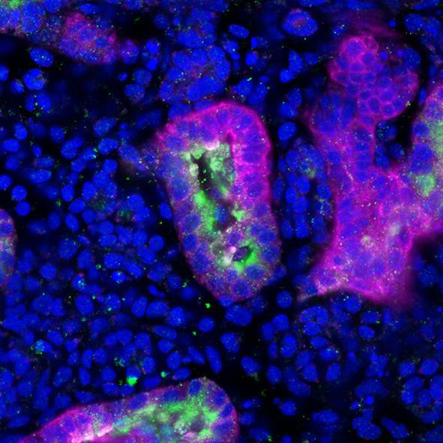
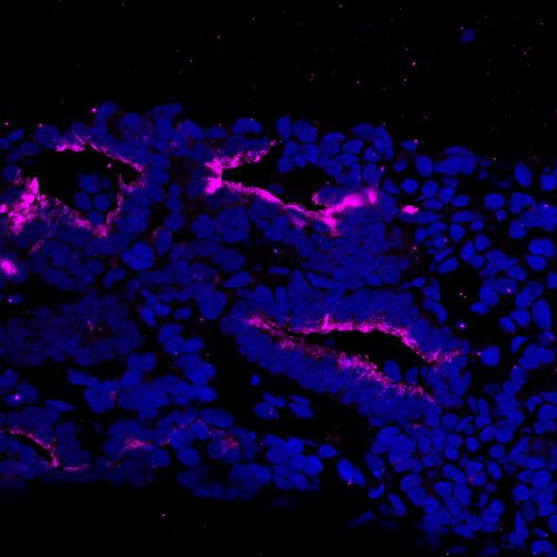
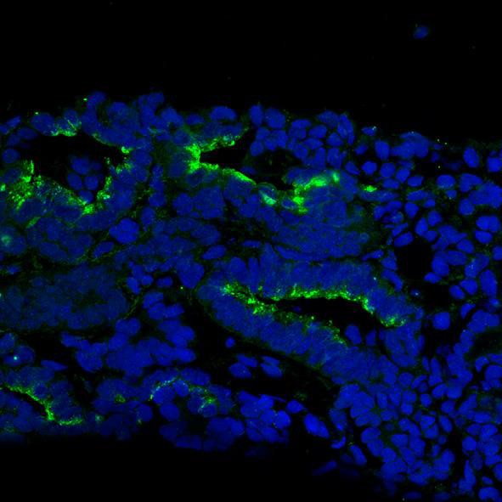
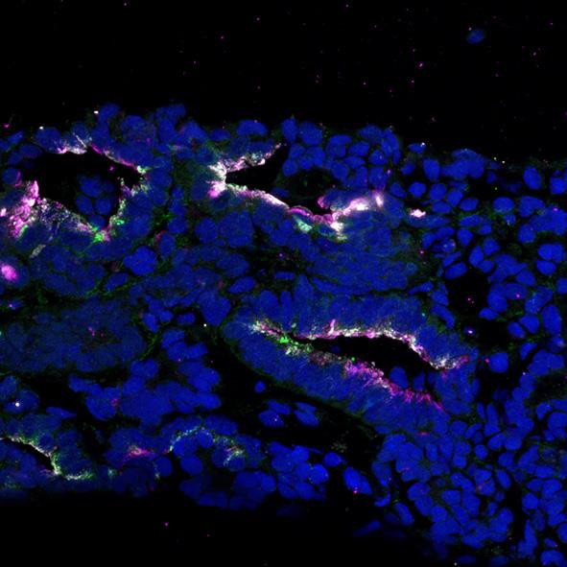
PT expresses both Megalin and Cubilin
Cubilin LTL DAPI
50 μm
Megalin DAPI
Cubilin DAPI
merge
50 μm

Slide 18
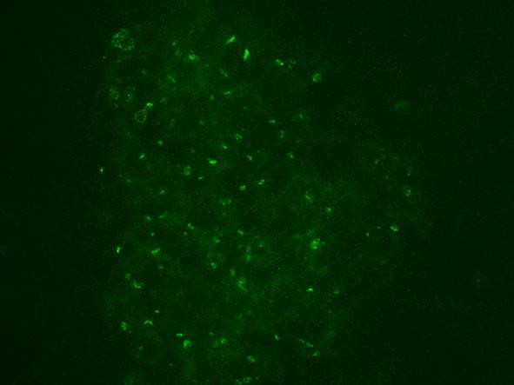
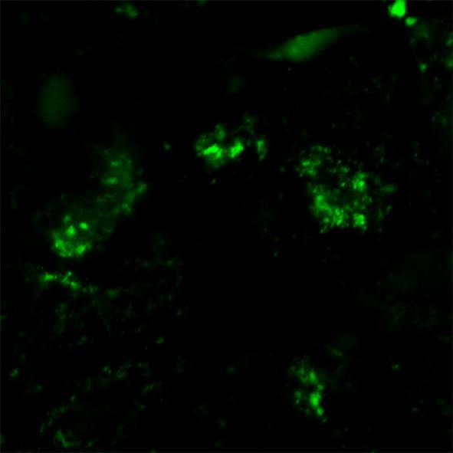
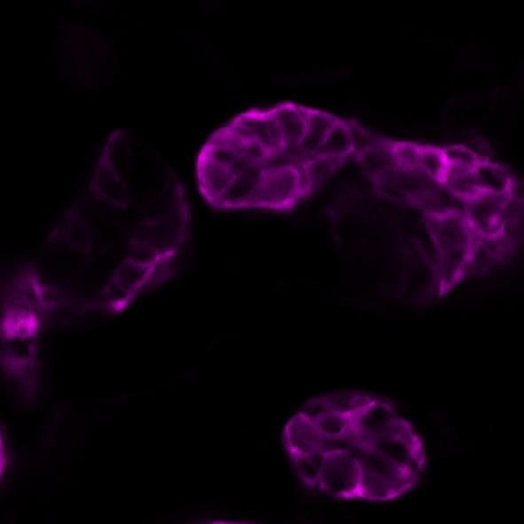
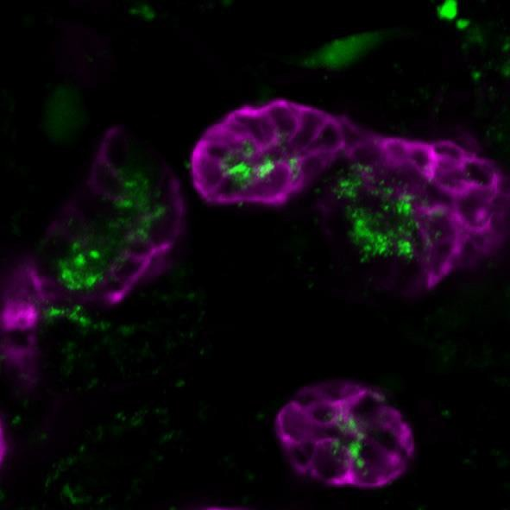
Dextran uptake in proximal tubules
24h Dextran-488
Dextran: a polysaccharide endocytosed by the PT
Dextran
LTL merge

Slide 19
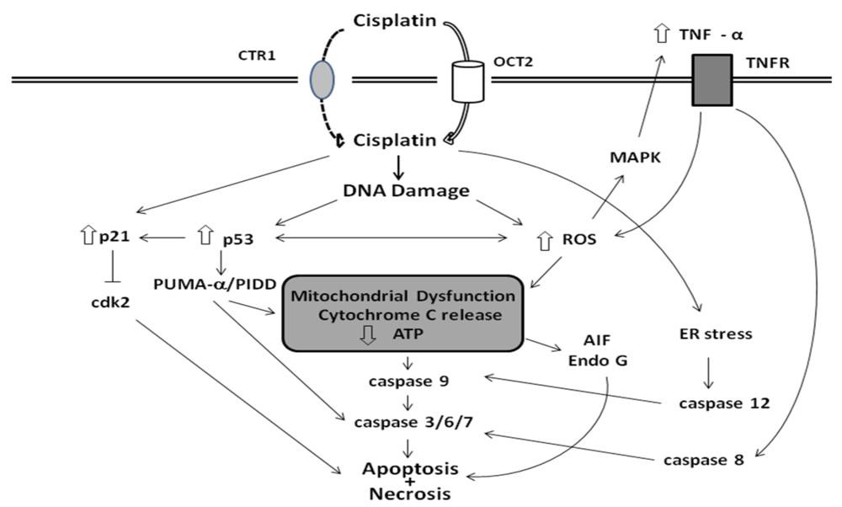
Cisplatin induces acute apoptosis in PT
(RP Miller et al, Toxins 2010)

Slide 20
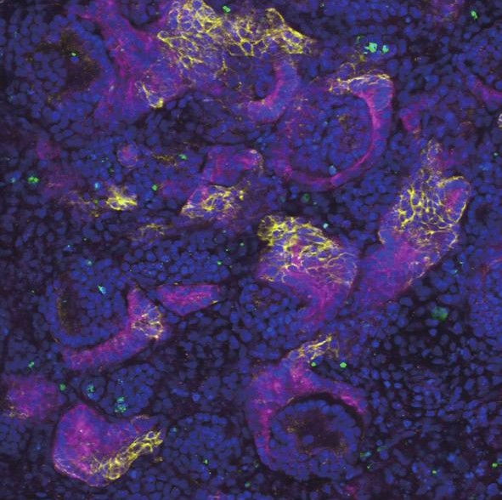
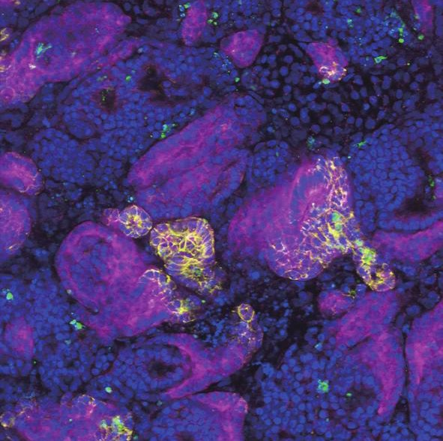

Low dose Cisplatin induced tissue specific cell death
24h Cisplatin [μM]
20
0
100
100 μm
LTL ECAD cleaved-CASP3 DAPI

Slide 21






Low Cisplatin induced matured PT-specific apoptosis
0 μM
20 μM
LTL ECAD cleaved-CASP3 DAPI

Slide 22

Low Cisplatin induced matured PT-specific apoptosis

Slide 23

Renal tubules uptake gentamicin by endocytosis
(Servais H. Apoptosis 2008)

Slide 24






Gentamicin induced podocyte specific cell death
0mM Gentamicin 48h 10mM Gentamicin 48h
LTL NPHS1 CASP3
100μm
100μm
100μm
DAPI
(Unpublished)

Slide 25




Gentamicin induced podocyte specific cell death
#1 #2
LTL NPHS1 DAPI
LTL NPHS1 DAPI
50μm
50μm
+CASP3
+CASP3
(Unpublished)

Slide 26
kidney organoids are not transplantable yet
1. Glomeruli are not fully vascularized
2. Ureter does not develop in the organoid
glomeruli endothelia
Cell heterogeneity is not perfectly controlled.
Cells are not well matured

Slide 27

Organo-on-a-chip for vascularisation of organoids
代表：横川 隆司、分担：荒岡（CiRA）、山下（CiRA）、高里（理研）、榎木（タカラバイオ）

Slide 28





Transplanted kidney organoids were vascularized
Transplanted under renal capsule
7 days after
Meca32
(Mouse
blood vessel)
(Stem Cell Reports, 2018)
In vitro
transplantation
Glomerulus Blood vessels
(Yabuuchi, Unpublished data)

Slide 29








Kidney organoids can survive with the bladder under transplantation
transplantation
will fail to grow
Kidney organoid only
Urine causes hydronephrosis
Kidney organoid
can mature in vivo
transplantation
Bladder organoid
combination
Urine can exit to the bladder

Slide 30


Bladder Development
iPS → endoderm → hind gut
→ Cloaca→ urothelium

Slide 31



謝辞
Takasato Lab RIKEN BDR
Wei Zhao（PD）
Filip Wymeersch（PD） Junichi Taniguchi （PD） Olena Trush (PD)
Chie Fukui (TS) Kensuke Yabuuchi（D4） Yoshiki Sahara（D3） Kazuhiro Ofuji（D3）
Rio Noto（D4） Wataru Uno（D3） Masaya Goto (M2)
Hiroki Matsunaga（OB）
Thomas Kluiver (visiting stu.)
Otsuka Pharmaceutical Co.
Ryuji Yokokawa, Kyoto University
Murdoch Children’s Research Institute Leiden University Medical Center Yokogawa Electric Corp.（CQ1）
Supported by,

